Slide 1
Papua New Guinea’s National Environmental Management Regime for Deep Sea Mineral Activities. What are the gaps and assistance needed?”
Gretel Orake
Manager, Technical Assessment Branch
Regulatory Operations Division
Mineral Resources Authority
10th December 2013
Tanoa International Hotel, Nadi, FIJI

Slide 2
Where we came from…
Mining (Bougainville Copper Agreement) Act 1967
1975 Gained Independence from Australia
Constitution & National Goals
Mining (Ok Tedi Agreements) Act 1976
Environmental Planning Act 1978
Environmental Contaminants Act 1978
Conservation Areas Act 1978
1988 Start of 10year civil war relating to Panguna mine Bougainville Is.
Environmental Planning Regulations 1992
Water Resources Act 1992
Mining Act 1992
Notes:
The Constitution of the Independent State of Papua New Guinea established and directs that all natural resources within its domain shall be exploited meaningfully and replenished where possible without compromising the capacity of the future generation to survive.

Slide 3
Here we are…
Legislation and Policy on Mining & Environment
Mining Act 1992
Mining Safety 1977
Mining Policy 1997
Environment Act 2000
Conservation Areas Act 1978
Environment (Prescribed Activities) Regulation 2002
Environment (Permits & Transitional) Regulation 2002
Environment (Fees & Charges) Regulation 2002
Income Tax Act
Foreign Exchange Act & Regulations
Land Act
Customs Act

Slide 4
Application of Laws
Definition of Deep Sea Mining in PNG is informed by the Mining Act 1992’s definition of land.
Land under sea is ‘Land’
Mining of any form on land is considered mining
Mine Feasibility Study
Geological Resources Estimates, Capex,Opex, Environment, Socio-economic
Environmental Considerations
Environment Permit is pre-requisite to granting of mining lease
Environment Act 2000 is applied
Environmental & Socio-Economic impact assessments included
Benefit Sharing
Determined by Several government policies & agencies
Requires a collaborative effort & transparent monitoring and evaluation.

Slide 5
Environmental Management
Dual systems
Ok Tedi & Bougainville
Ok Tedi Change Notices – Environment Regime (Environment Permit+Environment Management Plan in one)
All other mines
Environment Permit
Environmental Management Plans developed as conditions of permit after EIS is assessed and approved.
Influenced by developmental goals

Slide 6
PNG Going forward…
Vision 2050 – Healthy Wealthy Happy Safe
PNG Strategic Development Plan 2010-2030
Targets a Double income from mining sector by 2030
Whole Mining Regime under review
Expected enactment by June 2014
Offshore Mining Policy
Depends on political stability
Challenge of reaching mining target and translating that income into tangible benefits to people resulting in Vision 2050.

Slide 7
The O’Neill Government – political stability, consolidation & investment…
Constitutional changes passed – providing confidence for stable Government
Expansionary fiscal policy
Infrastructure focus underway, especially vital road upgrades i.e. Highlands Highway.
Anti corruption initiatives

Slide 8
Anti – corruption agenda
Taskforce Sweep – corruption & fraud investigation unit
Independent Commission against Corruption to be established
Public Prosecutor establishes a ‘Serious Corruption & Dishonesty Unit’
The Unit will prosecute offences of misappropriation and official corruption + Taskforce Sweep matters
Initiatives for greater public disclosure

Slide 9
EITI
Extractive Industries Transparency Initiative
PNG targeting December 2013 as application date for candidate country status
Includes revenue disclosure
Public disclosure of mining sector licence and agreement information
EITI capacity will be built into the new mineral tenements management system – Flexicadastre (World Bank Technical Assisstance)

Slide 10
Development Snap Shot
$US19b Exxon Mobil LNG Project due to produce first gas in 2014 with 2 operational trains
Up to 5 trains may be achieved in the future given potential reserves & joint arrangements with other gas developers
Construction phase winding down – re-deployment of skilled workforce
Key mine developments looking to gas for electricity generation
Government infrastructure spend winding up – K1b allocated for 2013
Road extensions/upgrades/sealing planned for over 1000kms of urban, provincial & national roads over the next 4 years

Slide 11
PNG Economic Review: Bank of PNG
2013 real GDP growth 5% - not bad by world standards
Expansionary fiscal policy to encourage economic activity
Kina fall over past 3 months – 16% against $AUD ($0.4076); 13.7% against $USD ($0.3830)
Positive impact on PNG export commodities
Inflation at 3.2% to June 2013 – estimated 5.5% 2013; 6.5% 2014; 5.5% 2015

Slide 12
New Investors run the ruler over PNG opportunities
Frieda River prospect under due diligence as Glencore/Xstrata expedite divestment
Frieda River: World class – 20 year + mine life
1.9 billion tonnes @ 0.45% copper
Wide range & cross section of interested suitors
Very positive investor interest
Copper price remains favourable
Annual production estimates:
190,000 tonnes Cu
280,000 ozs Au

Slide 13
World first – leading edge technology
Solwara – Nautilus: Arbitration award clears the way for world’s first underwater mine
Development proposals will require reconsideration in light of arbitration delays
Resource estimation: 2.2 million tonnes @ 6.8% copper; 5 g/tonne gold; 23 g/tonne silver & 0.4% zinc
Annual production estimates:
250,000 ozs Au
100,000 tonnes Cu

Slide 14
Other opportunities
Alluvial sector - $200m+ pa potential – much opportunity for landowner joint ventures for bona fide & professional operators
Expanding mineral resource base – nickel (Ramu mine in production), coal, iron sands, molybdenum, rare earths, uranium, limestone, geothermal…

Slide 15
Challenges
Use of scientific information to inform policy and legislative review in a timely manner
Water quality measurement standards
Environmental Management options
Cradle to grave?
Ecosystems approach?
Sustainable development?
Cost benefit analysis of a development decision to environment
How much is acceptable degradation?
What is allowable risk
Calculation of environmental bonds

Slide 16
Challenges cont’d
Lack of a nationwide State of the Environment reporting framework

Slide 17
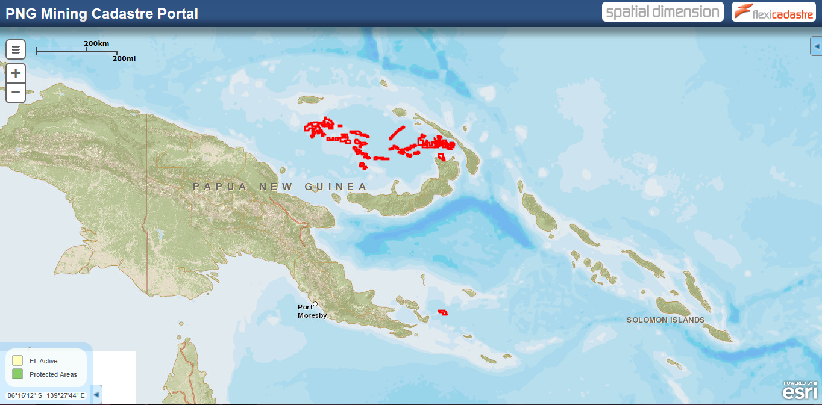
Em tasol… na tenku
http://portals.flexicadastre.com/png/

