Slide 1
FIJI – STATUS OF POLICY AND LEGISLATION DEVELOPMENT
MALAKAI FINAU
DIRECTOR, MINERAL RESOURCES DEPARTMENT
SPC-EU EDF10 DEEP SEA MINERALS PROJECT 1ST REGIONAL WORKSHOP,
NADI – 6th – 8th June 2011

Slide 2
The most extensive of the Polymettalic sulfide deposits within the Fiji EEZ are located within the North Fiji Basin, towards the northern parts {between 16-17 degrees south, and 173-174 degrees east} and have been extensively surveyed by research parties representing Japanese, French and German oceanographic and geological institutions. The deposits are located at a depth of around 2000m and occur as sulfide mounds, chimneys and surficial deposits. Both active venting and dead (fossil) chimneys are noted.
Although extensively surveyed, only the surficial extent of the deposits is known, the three-dimensional setting and therefore the true tonnage being unclear. Current research is aimed at expanding the known areal coverage and getting a handle on the thickness and variability with depth of the deposits, thus allowing for grade and tonnage estimation.

Slide 3
Seafloor Massive Sulfide Deposits in Fiji’s EEZ Hydrothermal activity within the Lau and North Fiji Basin back-arc basins were some of the first to be discovered in the SW – Pacific, earliest indications being the recognition of hydrothermal “signatures” within sediments cores and the water column from the northern parts of Lau and North Fiji Basins. Later marine scientific research [1987-1990] in the region confirmed the presence of active and fossil hydrothermal vent systems and recovered mineralised material. The deposits are entirely within deep water > 1900 meters, and close to sites of recent volcanism along the spreading axes. They appear associated with fracture zones and associated normal faults within axial caldera systems.

Slide 4
Exploration History #1
NUMEROUS GEOLOGICAL & GEOPHYSICAL CRUISES (Late 1970-1980’ and into the 1990’s)
Marginal Basin geology and petrology of volcanic suites
Identification of hydrothermal signatures in sediments and water column - North Fiji Basin
Understanding the evolution of the NFB and LB
All under MSR regime (UNCLOS)

Slide 5
Exploration History #2
Lau Basin
SO35 [1984-85]; SO 48 [1987]
Nautile dives [1989]
North Lau & Valu Fa Ridge [~18-23º S]
Keldysh/MIR [1990] - [~15º 23’S]
Many others including Ridge Program
KORDI 2007
Commercial expl 2008 (Nautilus, Neptune, Bluewater)

Slide 6
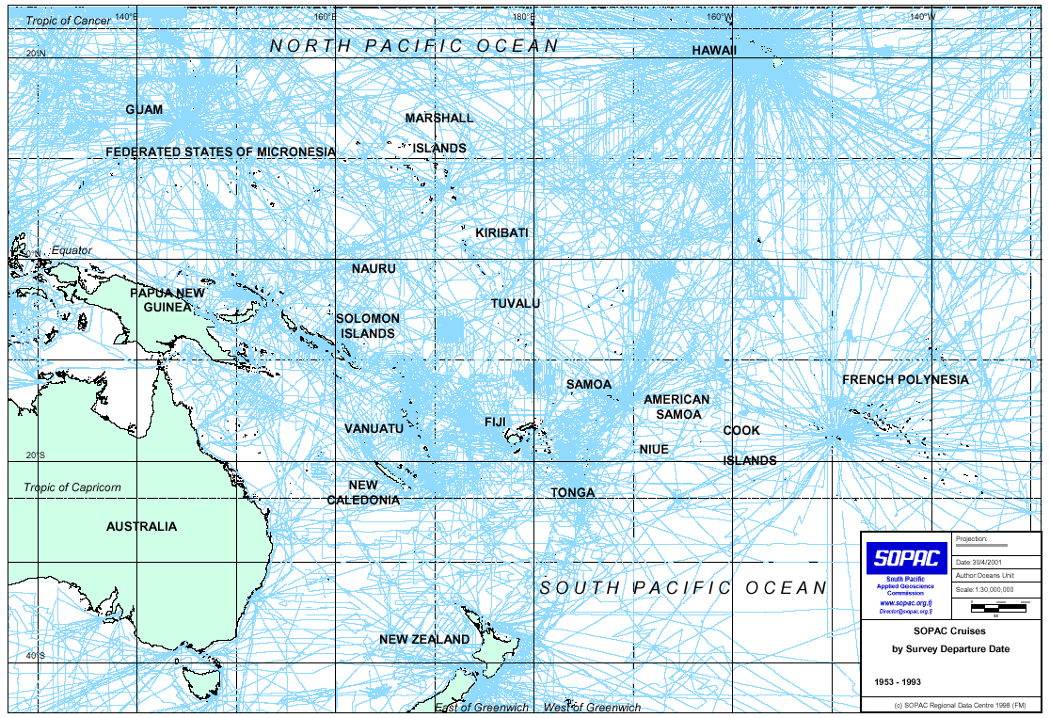
PACIFIC CRUISES - MSR

Slide 7
Map showing previous Marine Scientific Research (MSR) in Fiji’s EEZ

Slide 8
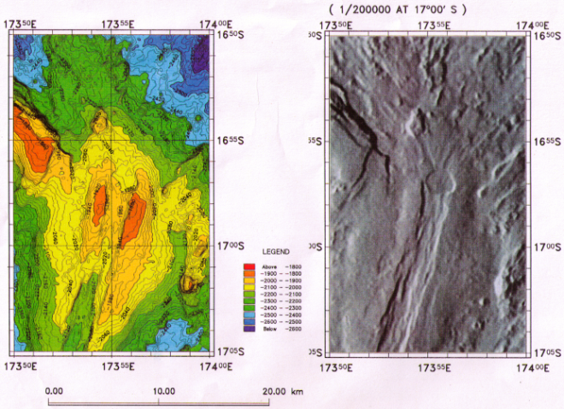
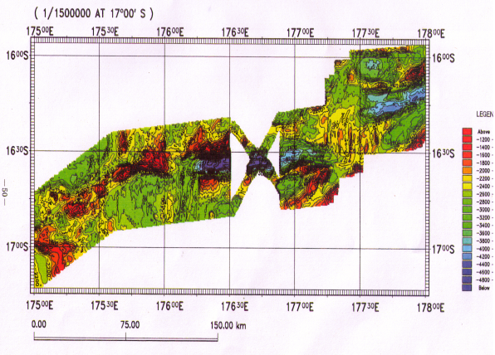
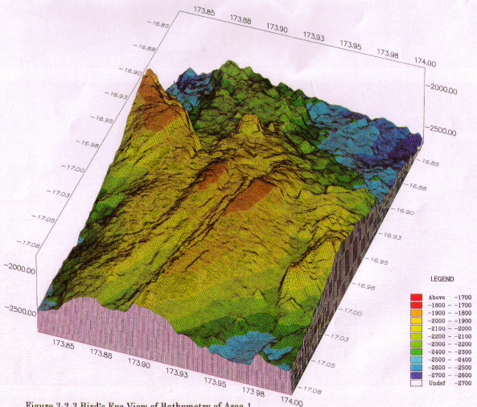
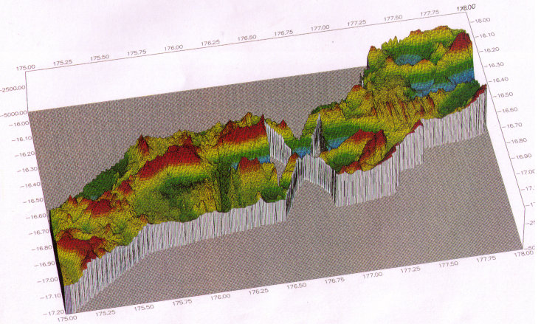
Map of Known Deep sea mineral deposits in Fiji

Slide 9
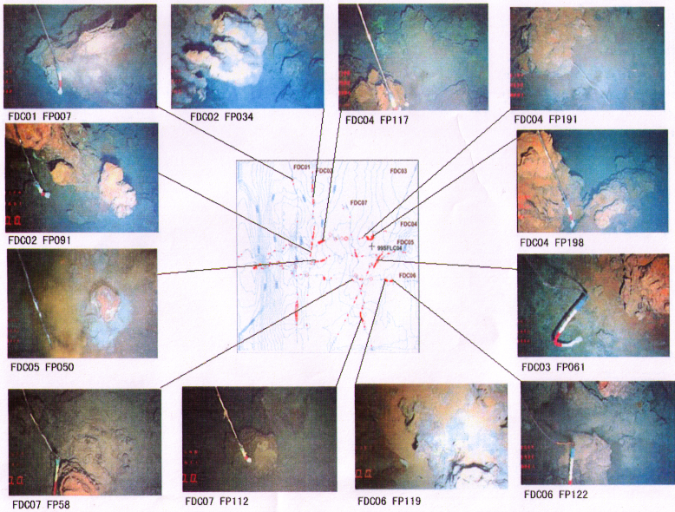
Triple Junction, Area 2: Typical Chimney-Mound Observed by FDC

Slide 10
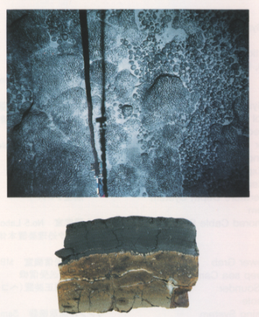
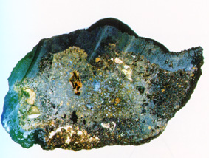
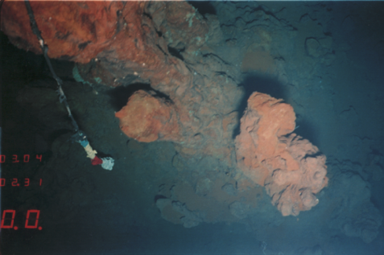
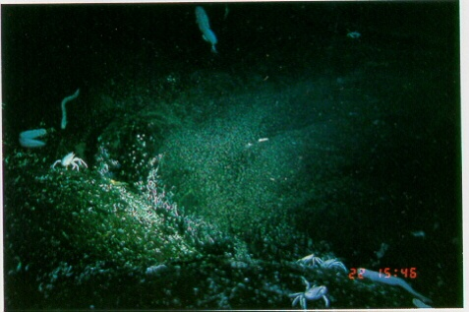
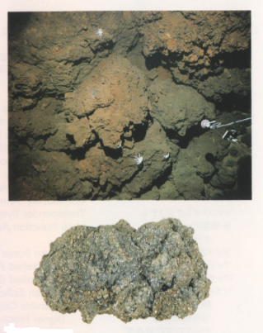
Types of deposits observed in the North Fiji Basin
Co-rich Manganese crusts
Polymetallic Massive Sulphide deposits

Slide 11
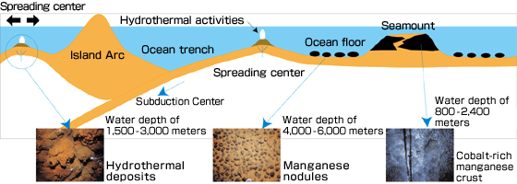

Slide 12
Average Compositions

Slide 13
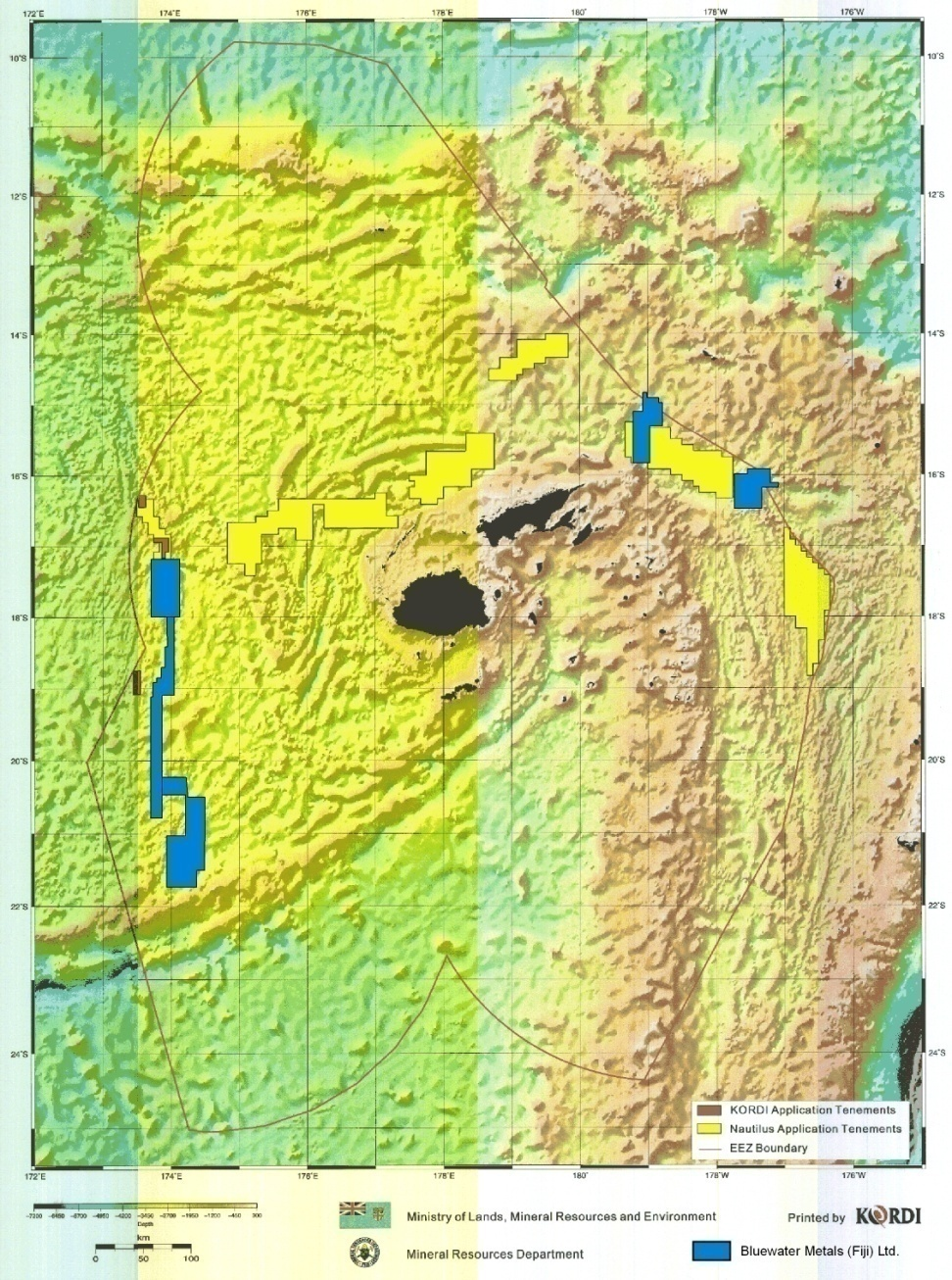
4.0 Appendix 3 - Areas Under Application

Slide 14
CHALLENGES IN POLICY AND LEGISLATION DEVELOPMENT
BACKGROUND - Fiji Mining Act 1978
The present Mining Act 1978 and Regulations Cap 146 sets out the mandatory requirements governing the regulation and management of the mining industry in the Fiji Islands. However, this statute accompanied by the Continental Shelf Act 1978 and the Marine Spaces Act 1977 fail to address in any detail, offshore mineral exploration or Deep Sea Minerals (DSM).

Slide 15
The Continental Shelf Act (1978) and the Marine Spaces Act (1977) provide an interim baseline for determining the outer limits of the territorial sea, exclusive economic zone, and the continental shelf. The final outer limits of its national jurisdiction is subject to the deliberation of a submission before the UN Commission on Conventions on the Law of the Sea based on delimiting in accordance with the relevant provisions of the UN Conventions on the Law of the Sea 1982.

Slide 16
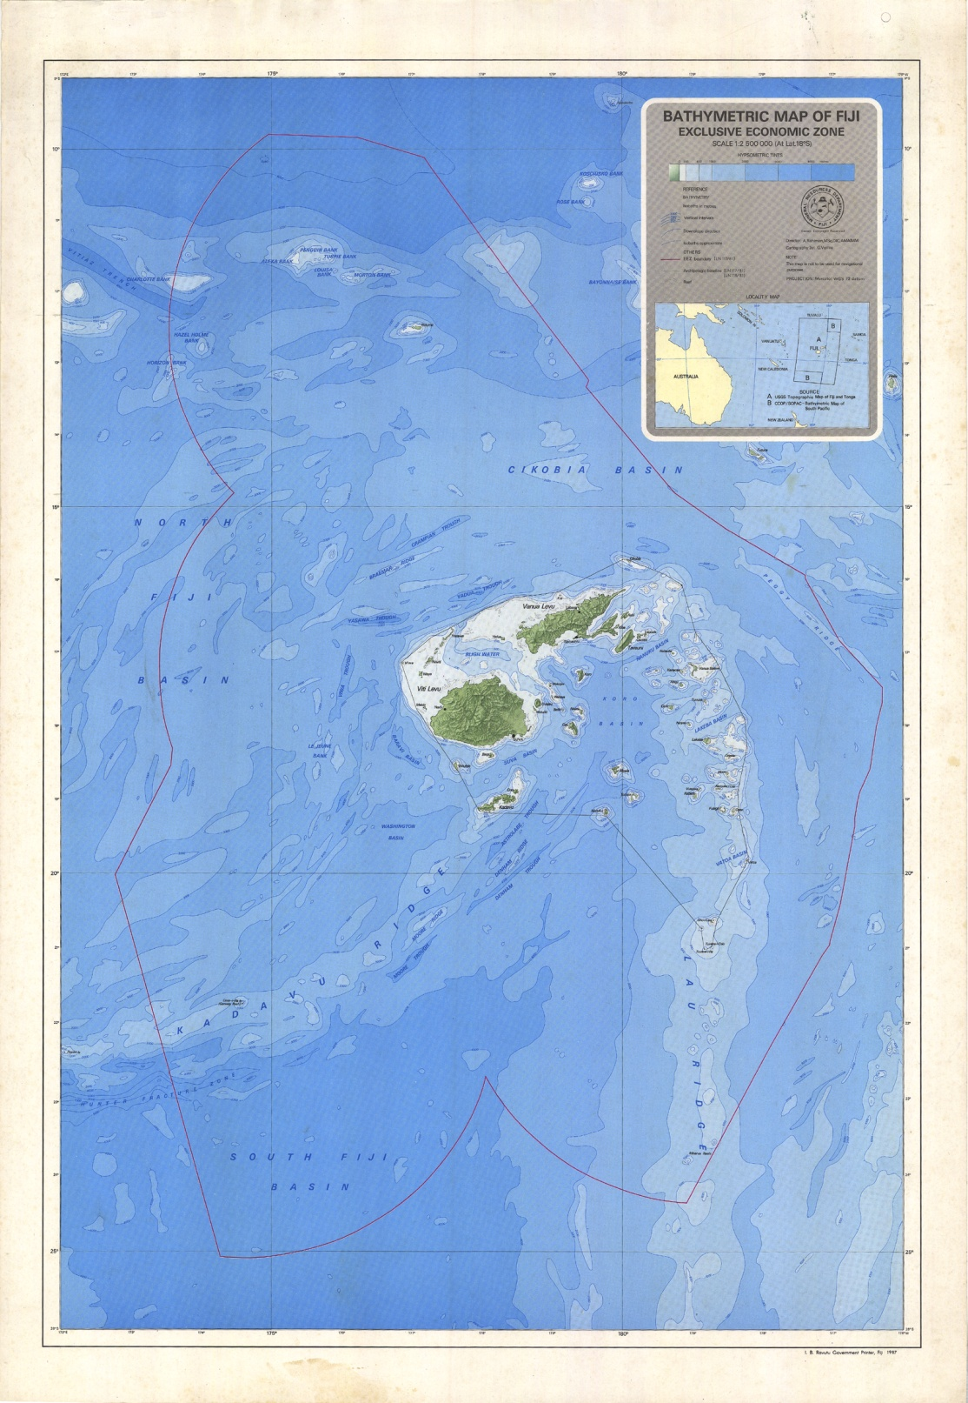

Slide 17
Fiji’s Offshore Minerals Policy
In order that Fiji realises the unknown potential of mineral and hydrocarbon occurrences on or below the seabed and in a manner that safeguards the environment for future generations, Cabinet had decided in 2007 that a moratorium be placed on issuing any exploration license until an Offshore Minerals Policy is formulated and adopted.
The Ministry of Lands and Mineral Resources had conducted wide consultations with key stakeholders to formulate a Draft Policy

Slide 18
In order to implement Cabinet Decision to uplift moratorium on offshore exploration, a legal amendment was required to extend the definition of land to include “the seabed and the deep seabed and subsoil of the area” which would enable the Mining Act to apply to offshore or deep-sea minerals.
Note that this amendment is only to permit exploration and not mining, which will only be granted upon development of a separate Offshore Mining legislation.

Slide 19
Apart from this Section, the Ministry for Lands and Mineral Resources determined that to facilitate administration of licences in the offshore region extending to the Exclusive Economic Zone (EEZ), an appropriate grid system was required.
The grid description is now as inserted into the Decree under Section 4 which now works in conjunction with the preceding Section 3 that extends the definition of land to cover the sea-bed.
Further, in alignment with the Offshore Minerals Policy, a revised fee schedule has been proposed for regulation. This fee structure takes into account proposed changes to the land-based fees as recommended by Ministry of Finance in 2009. A scaling factor was applied in recognition of the emerging sector which carries pioneering risks that require highly specialized expertise at all stages of licencing.

Slide 20
The process of assessment, grant and management or monitoring of licenses are identical to that of on-shore licenses since the environment (sea) has changed but scientific and economic principles are equally applicable regardless of onshore or offshore mineral deposits.
To address the uncertainties in terms of impact of offshore activities on the deep sea environment the Fiji government has adopted and applied the precautionary principle as applied through Marine Scientific Research provisions under UNCLOS. These include having Nationals on board during the exploration phase and equal access to all methods and data as well as leading researchers of the marine environment gathering baseline data.

Slide 21
There are two key issues that stand out when viewing offshore mining. These issues are predominantly brought to the forefront for deep seabed minerals such as polymetallic massive sulfide (PMS) deposits that are of a highly localised nature. Firstly, the dimensionality of deep seabed PMS deposits is very poorly known.
Therefore it is difficult to apply any kind of economic criteria to ascertain their viability as economically mineable deposits. Scheduled Marine Scientific Research (MSR) to drill these deposits should assist in a better understanding of the nature of these deposit types.

Slide 22
The other major issue is technology development. While the technology is available for the mining of offshore placer (or disseminated) deposits and for manganese nodule mining, the technology is not available for mining deep ocean floor buried deposits. Again, economic viability cannot be determined when the technology for extraction and its capital costs are unknown (though Nautilus is in the process of mining in Solwara 1).
Many unknowns exist with respect to issues of environmental concern. Knowledge of future applications of reef and other marine biota for pharmaceutical and other applications is only beginning to evolve. The long-term effects of deep-sea bed mining on the deep ocean floor environment have been researched extensively by the Japanese with respect to manganese nodule mining. However, little is known about the effects on the biota of mining sub-marine chimneys along rift zones. Another issue is conservation of resources. The present method for mining manganese nodules is inherently wasteful, recovering approximately only 30% of the resources.

Slide 23
There are still legal issues to be resolved. For example, delineation of jurisdictional zones (EEZ) still needs to be done by many of the countries. Development of general regulations in the EEZ by the Fiji Foreign Affairs Ministry still needs to be undertaken. Fishing rights and navigational zone rights must be taken into consideration with respect to offshore mining activities. Fiji must develop the capability to effectively monitor offshore mining activity. The appropriate dispute resolution mechanisms must be developed.
The fiscal regime must necessarily be different for offshore mining to reflect the greater risks and the need to stimulate development. Therefore fiscal incentives may be offered for research and development that are not available for terrestrial mining. Fiji must make decisions around whether it wants to attract a pioneer operator. To attract investment within the country, Fiji may need to offer certain tax incentives such as awarding of duty free status.

Slide 24
In addition to these issues occupational health and safety regulations are still being advanced. Further community rights and benefit distribution mechanisms must be refined.
Whilst the policy is aimed at encouraging exploration and exploitation of minerals in the offshore, the State will ensure that environmental damage to the marine ecosystem is minimised and that the State also benefits from the exploitation of these resources. The risk taker (project developer) will be allowed appropriate return on investment commensurate with the risks taken.

Slide 25
Issues Since there are no physical borders, mining of one area can affect other areas. This is especially true for mining within the EEZ where sediment plume can not only drift towards the shelf of the continent but also into international waters and adjoining State’s EEZ. This problem is similar to that posed by air pollution that crosses boundary. While there are legal mechanism for controlling transboundary air pollution (e.g. European and Canadian agreement to control acid rain) there is no regulatory policy in effect in international law to control this kind of pollution. Hence a binding treaty may be required to prohibit pollution within international waters/adjoining State’s EEZ resulting from activities conducted within Fiji’s EEZ.

Slide 26
Transboundary Deposits? What if deposits are known to occur across national boundaries? - Regional cooperation in developing these deposits - monitoring of mining of deposits through accurate location and definition of the geographic distribution of deposits; identify the actual and potential impacts of exploiting deposits for the countries located near the deposit

Slide 27
CONCLUSIONS
Whilst the policy is aimed at encouraging exploration and exploitation of minerals in the offshore, the State will ensure that environmental damage to the marine ecosystem is minimised and that the State also benefits from the exploitation of these resources. The risk taker (project developer) will be allowed appropriate return on investment commensurate with the risks taken.

Slide 28
The Government of Fiji recognises that there is a tremendous potential for the development of its offshore mineral resources. The development of these resources will require the reconciliation of key policy issues within a dynamic framework that requires the collaboration of all stakeholders. The policy being developed has attempted to be as flexible as possible, given the unique characteristics of offshore mineral exploration and development and the relative unknown factors involved. Given time, and with the collaboration of all stakeholders, it is envisaged that this document will develop into a succinct and pragmatic policy document for the optimal development of Fiji’s offshore mineral

Slide 29
This Policy document recognises the conventions of UNCLOS with regards to the development of a legislative framework for the development of its offshore minerals, and also the key aspects of offshore mineral exploration and development. These include the impact of technological progress and technology transfer; the possible impact of offshore mining on the nation’s fishing industry; the possible impacts of offshore mining to the community and the environment; the impact of Marine Scientific Research in offshore mining; and its impact on the biota that exist on the seafloor around mineralised areas.

Slide 30
It is the belief of the Fiji Government that this document demonstrates the need for comprehensive and integrated legislation that is specific to the responsible management and development of offshore mineral resources. These objectives would appear to be best met by the development of an Offshore Mining Law under which these resources can be explored and exploited for the benefit of the peoples of Fiji.

Slide 31
The End – Questions?

