Slide 1
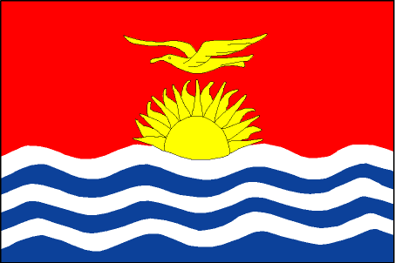
DSM Policy ISSUES
SOPAC-EU EDF10 Deep Sea Minerals Project
Kiribati National Workshop on Deep Sea Minerals

Slide 2
What must our Policy cover?
Issues relating to deep sea mineral activities (exploration and mining activities)
Sound management of our minerals resources
Regulations to protect and preserve our marine environment
Fiscal regimes
Kiribati receives maximum benefits from deep sea mineral activities
Financial gains
Capacity building and institutional developments

Slide 3
What we have
Mineral Development Licensing Ordinance
Foreshore and Land Reclamation Ordinance
Environment Act
Mining Ordinance

Slide 4
What we have but don’t have
They do not address the specific requirements that would cater for or address any relevant issues concerning deep sea mineral activities (exploration and possibly mining)
Provision is mainly for land based activities (i.e. mining ordinance for Banaba) and
Foreshore mining activities (i.e. Foreshore and Land Reclamation Ordinance, Environment Act)

Slide 5
International and Regional Stage
UNCLOS
ISA Regulations
Noumea Convention
Madang Guidelines

Slide 6
Way forward
Develop a policy that is in line with these:
UNCLOS – United Nations Convention on Law of the Sea
ISA Guidelines – Internationa Seabed Authority Guidelines
Noumea Convention
Madang Guidelines

Slide 7
Our task today
Development of Offshore Minerals Policy and Legislation, Regulations
Appropriate Management and Monitoring Framework/Guidelines for deep sea exploration and mining
Offshore Mining Legal Instruments in relation to existing National Policies, and Regional and International Conventions (e.g Noumea convention and UNCLOS).
Development of Marine Scientific Research Policy

Slide 8
Kam bati n rabwa!

